Slide 1





of
development
websites

Slide 2
Group Mumbers
&work devision
Leaders mathematics
Mumbers physics
chemistry
biology
structure
student mod
student mod
teacher mod

Slide 3
Ⅰ.Overall design
basis
backbone
HTML
HTTP
assist
Template engine
key
core
CGI
DBMS

Slide 4



Ⅱ.Main function
Part 1
Part 2
Part 3
Register and Login
Test paper and Questionnaire
View and Edit

Slide 5
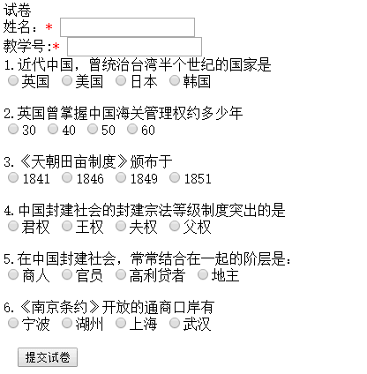
if(cgiFormString("ti1",ti1,sizeof(ti1))!=cgiFormSuccess)
{
fprintf(cgiOut,"请填写第一题！<br/>");
return;
if(cgiFormString("ti1",ti1,sizeof(ti1))!=cgiFormSuccess)
{
fprintf(cgiOut,"请填写第一题的答案！<br/>");
return;
if(strcmp(ti1,'b')==0)
{
fprintf(cgiOut,"第一题正确<br/>");
}
else
{
fprintf(cgiOut,"第一题错误<br/>");
fprintf(cgiOut,"提交成功"）}；

Slide 6
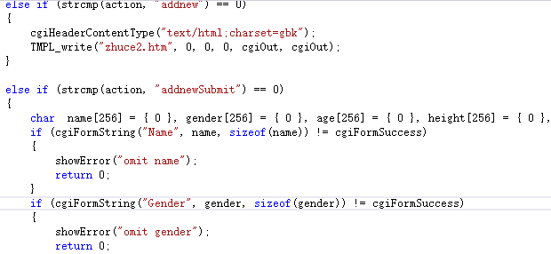
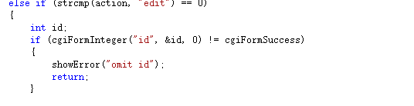
Addnew
Submit
Edit
Show Error

Slide 7
Ⅲ.bright spots
Novel project
2. Build environment
3. Facilitate user management

Slide 8






Ⅳ.Project experience
Challenge
Gain
Experience
Regret

Slide 9

Thank YOU

